Slide 1
Meeting 14-15
BRAND EQUITY
Dr. Sri Yanthy Yosepha, S.Pd. MM.

Slide 2
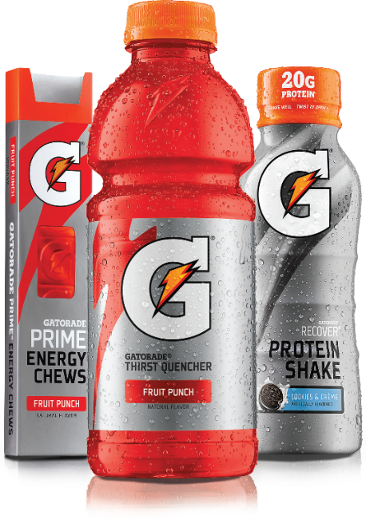
Learning Objectives
What is a brand, and how does branding work?
What is brand equity?
How is brand equity built?
How is brand equity measured?
How is brand equity managed?
What is brand architecture?
What is customer equity?

Slide 3
How Does Branding Work?
American Marketing Association
A brand is “a name, term, sign, symbol, or design, or a combination of them, intended to identify the goods or services of one seller or group of sellers and to differentiate them from those of competitors”
Notes:
A brand is thus a product or service whose dimensions differentiate it in some way from other products or services designed to satisfy the same need. These differences may be functional, rational, or tangible—related to product performance of the brand. They may also be more symbolic, emotional, or intangible— related to what the brand represents or means in a more abstract sense.

Slide 4
The role of brands
Brands’ role for consumers
Set and fulfill expectations
Reduce risk
Simplify decision making
Take on personal meaning
Become part of identity
Notes:
A brand is a promise between the firm and the consumer.

Slide 5
The role of brands
Brands’ role for firms
Simplify product handling
Organize inventory & accounting
Offer legal protection
Create brand loyalty
Secure competitive advantage
Notes:
To firms, brands represent enormously valuable pieces of legal property that can influence consumer behavior, be bought and sold, and provide their owner the security of sustained future revenues. Companies have paid dearly for brands in mergers or acquisitions, often justifying the price premium on the basis of the extra profits expected and the difficulty and expense of creating similar brands from scratch. Wall Street believes strong brands result in better earnings and profit performance for firms, which, in turn, create greater value for shareholders.

Slide 6
The Scope of Branding
Branding
The process of endowing products and services with the power of a brand
Notes:
It’s all about creating differences between products. Marketers need to teach consumers “who” the product is—by giving it a name and other brand elements to identify it—as well as what the product does and why consumers should care. Branding creates mental structures that help consumers organize their knowledge about products and services in a way that clarifies their decision making and, in the process, provides value to the firm.

Slide 7
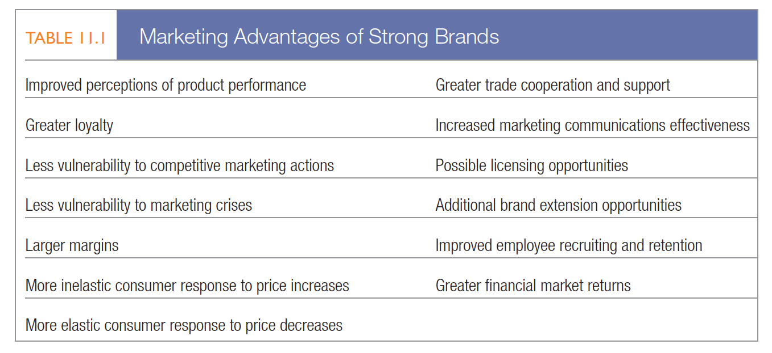
Defining Brand Equity
Brand equity
Added value endowed to products with consumers
Notes:
Brand equity may be reflected in the way consumers think, feel, and act with respect to the brand, as well as in the prices, market share, and profitability it commands.

Slide 8
Defining Brand Equity
Customer-based brand equity
The differential effect brand knowledge has on consumer response to the marketing of that brand
Differences in consumer response
Brand knowledge
Perceptions, preferences, and behavior
Notes:
A brand has positive customer-based brand equity when consumers react more favorably to a product and the way it is marketed when the brand is identified than when it is not identified. A brand has negative customer-based brand equity if consumers react less favorably to marketing activity for the brand under the same circumstances.

Slide 9
Defining Brand Equity
Brand promise
The marketer’s vision of what the brand must be and do for consumers
Notes:
Virgin’s brand promise is to enter categories where customers’ needs are not well met, do different things, and do things differently, all in a way that better meets those needs. With Virgin America, the company appears to have come up with another brand winner.

Slide 10
Brand Equity Models
BrandAsset® Valuator
Brandz
Brand Resonance Model
Notes:
Although marketers agree about basic branding principles, a number of models of brand equity offer some differing perspectives. Here we highlight three more established ones.

Slide 11
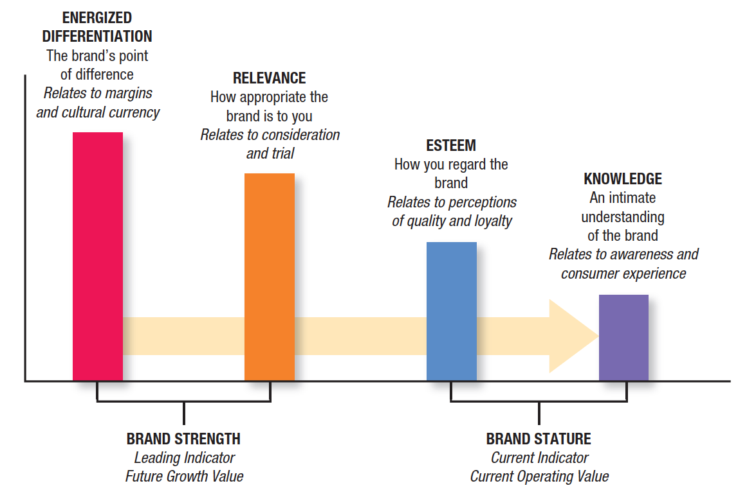
Brand Equity Models
BrandAsset® Valuator
Energized differentiation
Relevance
Esteem
Knowledge
Notes:
Advertising agency Young and Rubicam (Y&R) developed a model of brand equity called the BrandAsset® Valuator (BAV). There are four key components—or pillars—of brand equity, according to BAV (see Figure 11.1). Energized differentiation measures the degree to which a brand is seen as different from others as well as its pricing power. Relevance measures the appropriateness and breadth of a brand’s appeal. Esteem measures perceptions of quality and loyalty, or how well the brand is regarded and respected. Knowledge measures how aware and familiar consumers are with the brand and the depth of their experience.
Energized differentiation and relevance combine to determine brand strength—a leading indicator that predicts future growth value. Esteem and knowledge together create brand stature, a “report card” of past performance and a lagging indicator of current operating value.

Slide 12
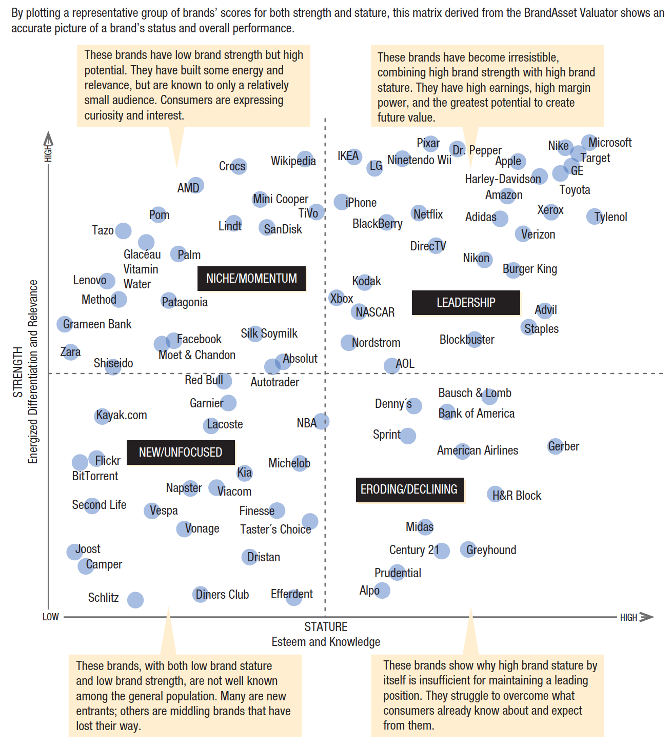
The Universe of Brand Performance
Notes:
The relationships among these dimensions—a brand’s “pillar pattern”—reveal much about a brand’s current and future status. Brand strength and brand stature combine to form the power grid, depicting stages in the cycle of brand development in successive quadrants (see Figure 11.2). Strong new brands show higher levels of energized differentiation and energy than relevance, whereas both esteem and knowledge are lower still. Leadership brands show high levels on all pillars, with strength greater than stature. As strength slips, they become mass market brands. Finally, declining brands show high knowledge—evidence of past performance—a lower level of esteem, and even lower relevance and energized differentiation.

Slide 13
Brand Equity Models
Brandz
Meaningful, different, & salient associations
Power, premium, & potential outcomes
Notes:
Marketing research consultants Millward Brown and WPP have developed the Brandz model of brand strength, at the heart of which is the BrandDynamics™ model, a system of brand equity measurements, based on Millward Brown’s Meaningfully Different Framework, that reveals a brand’s current equity and opportunities for growth (Figure 11.3).* BrandDynamics employs a set of simple scores that summarize a brand’s equity and are relatable directly to real world financial and business outcomes. BrandDynamics maintain that three different types of brand associations are crucial for building customer predisposition to buy a brand—meaningful, different, and salient brand associations. The success of a brand along those three dimensions, in turn, is reflected in three important outcome measures:
Power: a prediction of the brand’s volume share
Premium: a brand’s ability to command a price premium relative to the category average
Potential: the probability that a brand will grow value share

Slide 14
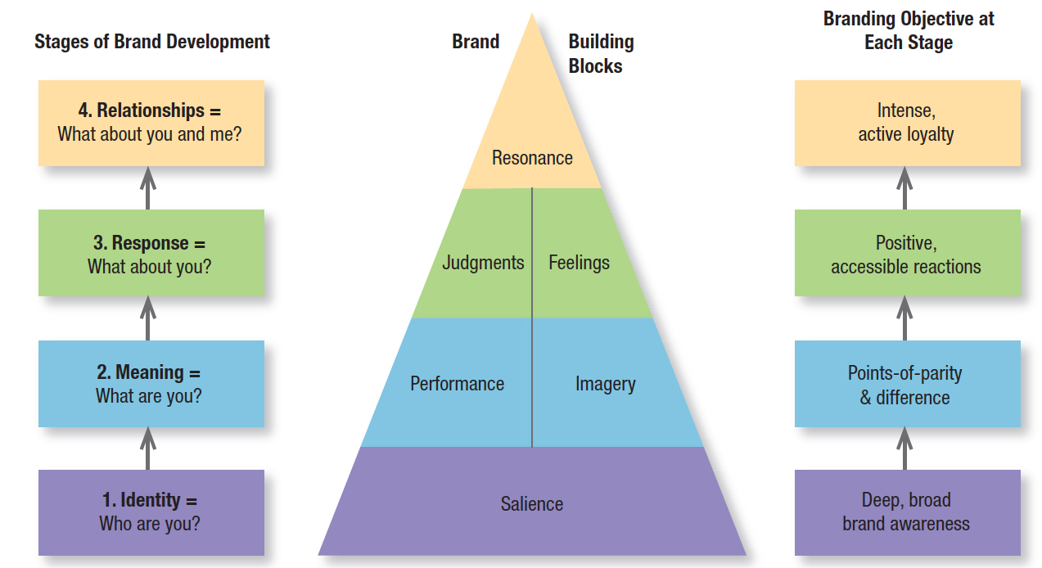
Brand Equity Models
Brand Resonance Pyramid
Notes:
The brand resonance model also views brand building as an ascending series of steps, from bottom to top: (1) ensuring customers identify the brand and associate it with a specific product class or need; (2) firmly establishing the brand meaning in customers’ minds by strategically linking a host of tangible and intangible brand associations; (3) eliciting the proper customer responses in terms of brand-related judgment and feelings; and (4) converting customers’ brand responses to intense, active loyalty.
According to this model, enacting the four steps means establishing a pyramid of six “brand building blocks” as illustrated in Figure 11.4. The model emphasizes the duality of brands—the rational route to brand building is on the left side of the pyramid, and the emotional route is on the right side.
Creating significant brand equity requires reaching the top of the brand pyramid, which occurs only if the right building blocks are put into place.
• Brand salience is how often and how easily customers think of the brand under various purchase or consumption situations—the depth and breadth of brand awareness.
• Brand performance is how well the product or service meets customers’ functional needs.
• Brand imagery describes the extrinsic properties of the product or service, including the ways in which the brand attempts to meet customers’ psychological or social needs.
• Brand judgments focus on customers’ own personal opinions and evaluations.
• Brand feelings are customers’ emotional responses and reactions with respect to the brand.
• Brand resonance describes the relationship customers have with the brand and the extent to which they feel they’re “in sync” with it.

Slide 15
Building Brand Equity
Brand equity drivers
Brand element or identity choices
Product & accompanying marketing
Other associations
Notes:
Brand elements are devices, which can be trademarked, that identify and differentiate the brand. Most strong brands employ multiple brand elements. Nike has the distinctive “swoosh” logo, the empowering “Just Do It” slogan, and the “Nike” name from the Greek winged goddess of victory.

Slide 16
Building Brand Equity
Brand element choice criteria
Memorable
Meaningful
Protectable
Likable
Adaptable
Transferable
Notes:
There are six criteria for choosing brand elements. The first three—memorable, meaningful, and likable—are brand building. The latter three—transferable, adaptable, and protectable—are defensive and help leverage and preserve brand equity against challenges.

Slide 17
Designing Holistic Marketing Activities
Brand contact
Any information-bearing experience (positive or negative) a customer or prospect has with the brand, its product category, or its market
Notes:
Brands are not built by advertising alone. Customers come to know a brand through a range of contacts and touch points: personal observation and use, word of mouth, interactions with company personnel, online or telephone experiences, and payment transactions. Integrated marketing is about mixing and matching marketing activities to maximize their individual and collective effects. Marketers need a variety of different marketing activities that consistently reinforce the brand promise.

Slide 18
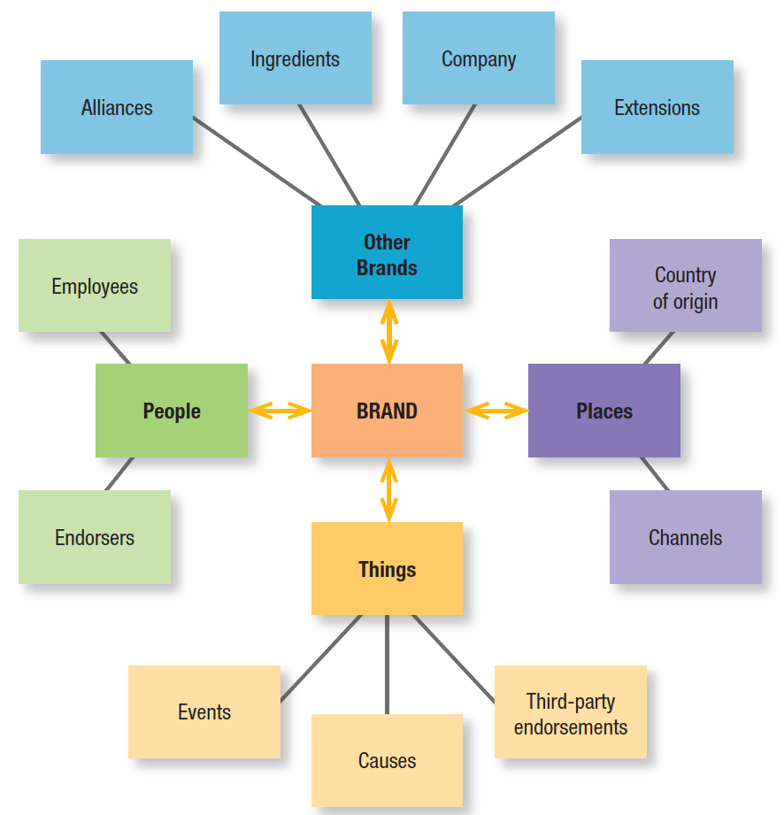
Leveraging Secondary Associations
Notes:
The third and final way to build brand equity is, in effect, to “borrow” it. That is, create brand equity by linking the brand to other information in memory that conveys meaning to consumers (see Figure 11.5). These “secondary” brand associations can link the brand to sources such as the company itself (through branding strategies), to countries or other geographical regions (through identification of product origin), and to channels of distribution (through channel strategy), as well as to other brands (through ingredient or co-branding), characters (through licensing), spokespeople (through endorsements), sporting or cultural events (through sponsorship), or some other third-party sources (through awards or reviews).

Slide 19
Internal Branding
Activities and processes that help inform/inspire employees about brands
Choose the right moment
Link internal & external marketing
Bring the brand alive for employees
Keep it simple
Notes:
Marketers must now “walk the walk” to deliver the brand promise. They must adopt an internal perspective to be sure employees and marketing partners appreciate and understand basic branding notions and how they can help—or hurt—brand equity.
When employees care about and believe in the brand, they’re motivated to work harder and feel greater loyalty to the firm. Some important principles for internal branding are:
Choose the right moment. Turning points are ideal opportunities to capture employees’ attention and imagination.
Link internal and external marketing. Internal and external messages must match.
Bring the brand alive for employees. Internal communications should be informative and energizing.
Keep it simple. Don’t overwhelm employees with too many details. Focus on the key brand pillars, ideally in the form of a brand mantra.

Slide 20
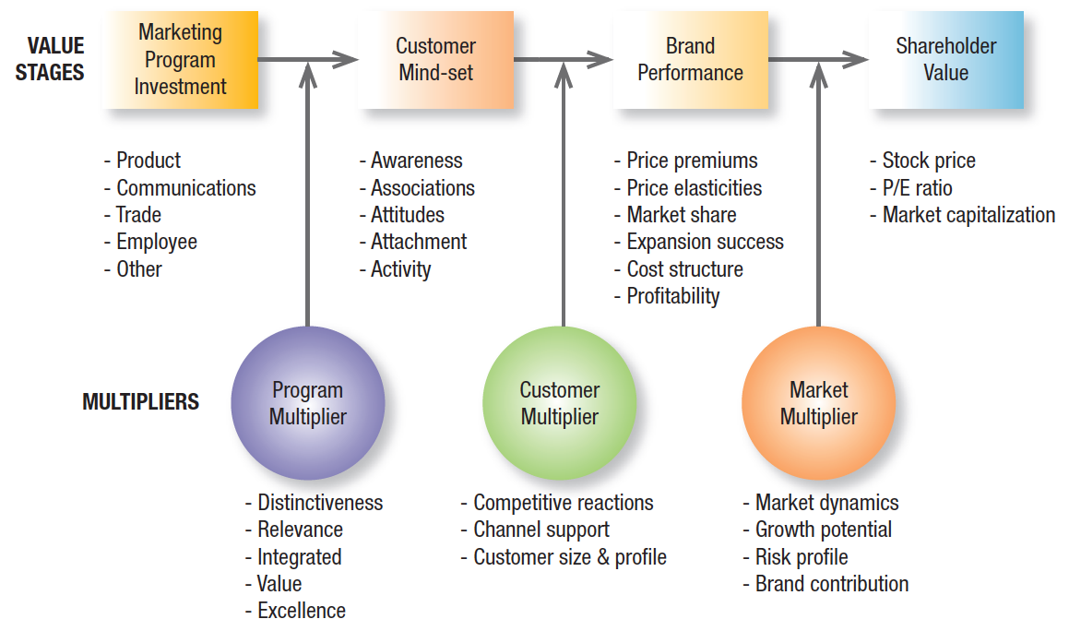
Measuring Brand Equity
Brand value chain
Notes:
The brand value chain is a structured approach to assessing the sources and outcomes of brand equity and the way marketing activities create brand value (Figure 11.6). Brand value creation begins when the firm targets actual or potential customers by investing in a marketing program to develop the brand, including marketing communications, trade or intermediary support, and product research, development, and design. Next, these customers’ mind-sets will affect buying behavior and the way consumers respond to all subsequent marketing activity—pricing, channels, communications, and the product itself—and the resulting market share and profitability of the brand. Finally, the investment community will consider this market performance of the brand to assess shareholder value in general and the value of a brand in particular.

Slide 21
Measuring Brand Equity
Brand audit
Brand-tracking studies
Brand valuation
Notes:
A brand audit is a focused series of procedures to assess the health of the brand, uncover its sources of brand equity, and suggest ways to improve and leverage its equity.
Brand-tracking studies use the brand audit as input to collect quantitative data from consumers over time, providing consistent, baseline information about how brands and marketing programs are performing. Tracking studies help us understand where, how much, and in what ways brand value is being created to facilitate day-to-day decision making.
Marketers should distinguish brand equity from brand valuation, which is the job of estimating the total financial value of the brand.

Slide 22
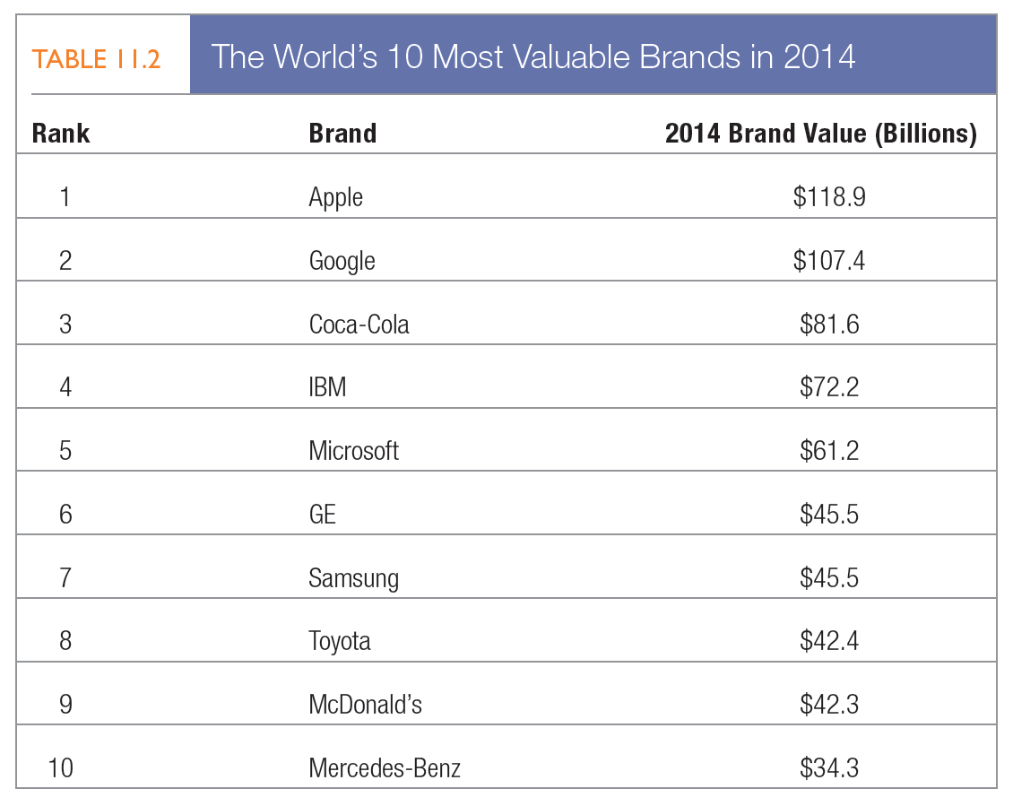
Measuring Brand Equity
Notes:
Table 11.2 displays the world’s most valuable brands in 2012 according to the Interbrand rankings, as described below in “Marketing Insight: What Is a Brand Worth?”61 In these well-known companies, brand value is typically more than half the total company market capitalization.

Slide 23
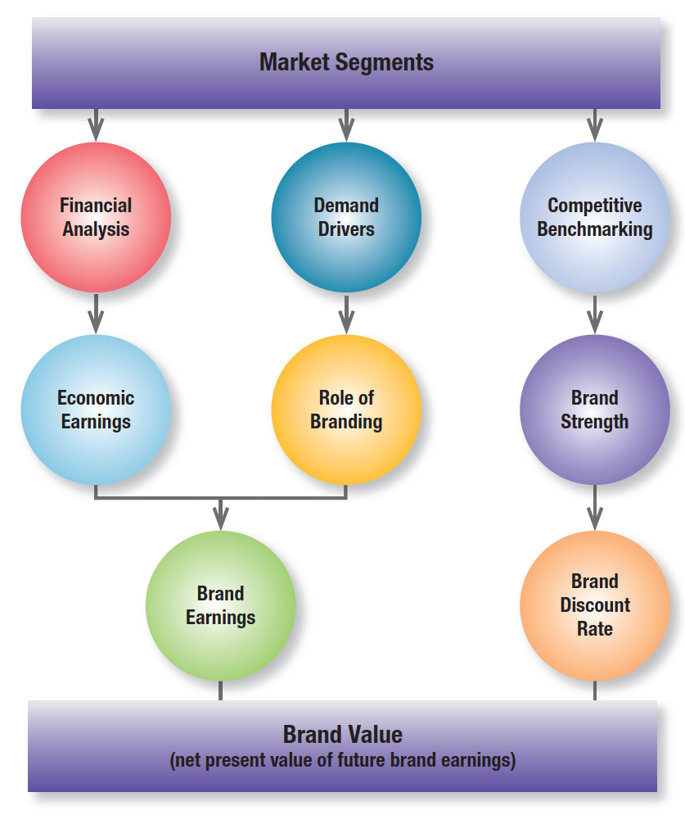
Interbrand Brand Valuation Method
Notes:
Top brand-management firm Interbrand has developed a model to formally estimate the dollar value of a brand. It defines brand value as the net present value of the future earnings that can be attributed to the brand alone. The firm believes marketing and financial analyses are equally important in determining the value of a brand. Its process follows five steps (see Figure 11.7 for a schematic overview).

Slide 24
Managing Brand Equity
Brand reinforcement
Requires the brand always be moving forward
Brand revitalization
Almost any kind starts with the product
Notes:
As a company’s major enduring asset, a brand needs to be carefully managed so its value does not depreciate. Brand leaders of 70 years ago that remain leaders today—companies such as Wrigley’s, Coca-Cola, Heinz, and Campbell Soup—only do so by constantly striving to improve their products, services, and marketing. Marketers can reinforce brand equity by consistently conveying the brand’s meaning in terms of (1) what products it represents, what core benefits it supplies, and what needs it satisfies; and (2) how the brand makes products superior and which strong, favorable, and unique brand associations should exist in consumers’ minds.
A number of brands have managed to make impressive comebacks in recent years.68 After some hard times in the automotive market, Cadillac, Fiat, and Volkswagen have all turned their brand fortunes around to varying degrees. Often, the first thing to do in revitalizing a brand is understand what the sources of brand equity were to begin with. Are positive associations losing their strength or uniqueness? Have negative associations become linked to the brand? Then decide whether to retain the same positioning or create a new one and, if so, which new one.

Slide 25
Devising a Branding Strategy
Can develop new brand elements for new product
Can apply some of existing brand elements
Can use a combination of new & existing brand elements
Notes:
A firm’s branding strategy—often called its brand architecture—reflects the number and nature of both common and distinctive brand elements. Deciding how to brand new products is especially critical. A firm has three main choices listed in this slide.

Slide 26
Devising a Branding Strategy
Brand extension
Sub-brand
Parent brand
Master/family brand
Line extension
Category extension
Brand line
Brand mix
Branded variants
Licensed product
Notes:
When a firm uses an established brand to introduce a new product, the product is called a brand extension. When marketers combine a new brand with an existing brand, the brand extension can also be called a subbrand, such as Hershey Kisses candy, Adobe Acrobat software, Toyota Camry automobiles, and American Express Blue cards. The existing brand that gives birth to a brand extension or sub-brand is the parent brand. If the parent brand is already associated with multiple products through brand extensions, it can also be called a master brand or family brand.
Brand extensions fall into two general categories. In a line extension, the parent brand covers a new product within a product category it currently serves, such as with new flavors, forms, colors, ingredients, and package sizes. In a category extension, marketers use the parent brand to enter a different product category, such as Swiss Army watches.
A brand line consists of all products—original as well as line and category extensions—sold under a particular brand. A brand mix (or brand assortment) is the set of all brand lines that a particular seller makes. Many companies are introducing branded variants, which are specific brand lines supplied to specific retailers or distribution channels.
A licensed product is one whose brand name has been licensed to other manufacturers that actually make the product.

Slide 27
Branding Decisions
Alternative branding strategies
Individual or separate
family brand names
Corporate umbrella or company brand name
Sub-brand name
Notes:
Assuming a firm decides to brand its products or services, it must choose which brand names to use. Three general strategies are popular:
Individual or separate family brand names. Consumer packaged-goods companies have a long tradition of branding different products by different names.
Corporate umbrella or company brand name. Many firms, such as Heinz and GE, use their corporate brand as an umbrella brand across their entire range of products.
Sub-brand name. Sub-brands combine two or more of the corporate brand, family brand, or individual product brand names.

Slide 28
Branding Decisions
House of brands
A branded house
Flagship product
Notes:
The use of individual or separate family brand names has been referred to as a “house of brands” strategy, whereas the use of an umbrella corporate or company brand name is a “branded house” strategy. These two strategies represent two ends of a continuum. A sub-brand strategy falls somewhere between, depending on which component of the sub-brand receives more emphasis.
With a branded house strategy, it is often useful to have a well-defined flagship product. A flagship product is one that best represents or embodies the brand as a whole to consumers. It often is the first product by which the brand gained fame, a widely accepted best-seller, or a highly admired or award-winning product.

Slide 29
Brand Portfolios
The set of all brands and brand lines a particular firm offers for sale in a particular category or market segment
Flankers
Cash cows
Low-end entry level
High-end prestige
Notes:
A brand can be stretched only so far, and all the segments the firm would like to target may not view the same brand equally favorably. Marketers often need multiple brands in order to pursue these multiple segments. The hallmark of an optimal brand portfolio is the ability of each brand in it to maximize equity in combination with all the other brands in it. Brands can also play a number of specific roles as part of a portfolio.
Flanker or fighter brands are positioned with respect to competitors’ brands so that more important (and more profitable) flagship brands can retain their desired positioning.
Some brands may be kept around despite dwindling sales because they manage to maintain their profitability with virtually no marketing support. Companies can effectively milk these “cash cow” brands by capitalizing on their reservoir of brand equity.
The role of a relatively low-priced brand in the portfolio often may be to attract customers to the brand franchise. Retailers like to feature these “traffic builders” because they are able to trade up customers to a higher-priced brand.
The role of a relatively high-priced brand often is to add prestige and credibility to the entire portfolio.

Slide 30
Brand Extensions
Introducing a host of new products under a firm’s strongest brand names
Improved odds of new-product success
Positive feedback effects
Risk of brand dilution
May harm parent brand
Firm forgoes creating new brand
Notes:
Most new products are in fact brand extensions—typically 80 percent to 90 percent in any one year. Moreover, many of the most successful new products, as rated by various sources, are brand extensions. Two main advantages of brand extensions are that they can facilitate new-product acceptance and provide positive feedback to the parent brand and company.
On the downside, line extensions may cause the brand name to be less strongly identified with any one product. Brand dilution occurs when consumers no longer associate a brand with a specific or highly similar set of products and start thinking less of the brand. The worst possible scenario is for an extension not only to fail, but to harm the parent brand in the process. One easily overlooked disadvantage of brand extensions is that the firm forgoes the chance to create a new brand with its own unique image and equity.

Slide 31
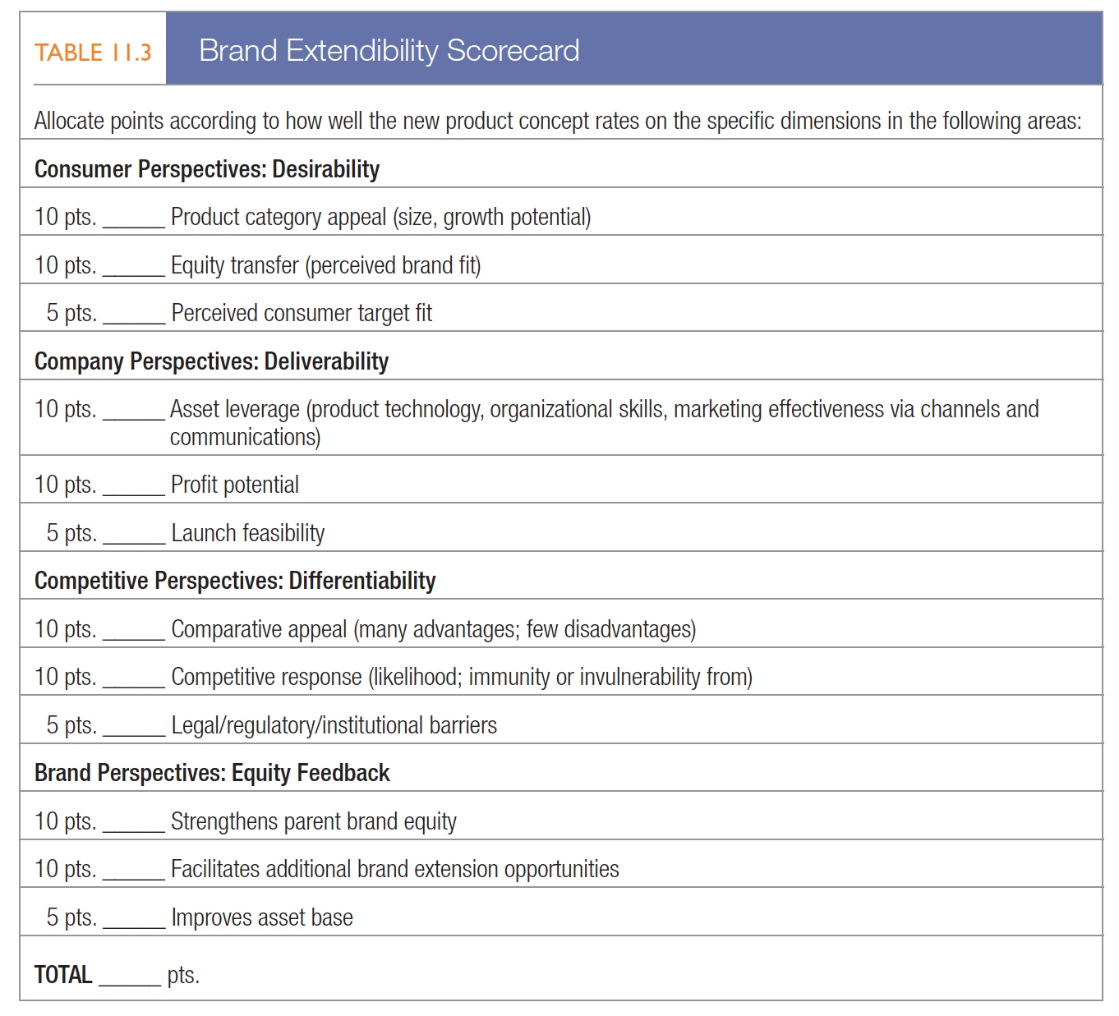
Brand Extensions
Notes:
Marketers must judge each potential brand extension by how effectively it leverages existing brand equity from the parent brand as well as how effectively, in turn, it contributes to the parent brand’s equity. Marketers should ask a number of questions in judging the potential success of an extension. To help answer these questions, Table 11.3 offers a sample scorecard with specific weights and dimensions that users can adjust for each application.

Slide 32
Customer Equity
The sum of lifetime values of all customers
Is affected by customer acquisition, retention, and cross-selling
Notes:
We can relate brand equity to one other important marketing concept: customer equity. The aim of customer relationship management (CRM) is to produce high customer equity.
As Chapter 5 reviewed, customer lifetime value is affected by revenue and by the costs of customer acquisition, retention, and cross-selling.
Acquisition depends on the number of prospects, the acquisition probability of a prospect, and acquisition spending per prospect.
Retention is influenced by the retention rate and retention spending level.
Add-on spending is a function of the efficiency of add-on selling, the number of add-on selling offers given to existing customers, and the response rate to new offers.
Both brand equity and customer equity matter. There are no brands without customers and no customers without brands. Brands serve as the “bait” that retailers and other channel intermediaries use to attract customers from whom they extract value. Customers are the tangible profit engine for brands to monetize their brand value.

